Slide 1

Logic, Semantic Nets, Frames

Slide 2
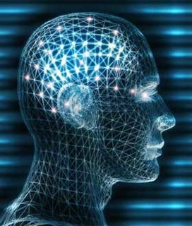
What is Logic?
Logic: the set of patterns used to carry out reasoning.
  It is a language used to represent facts.
Pattern: a template or a set of rules found as a result of observing commonalities.
Reasoning: is the act of using reason.
Reason: ability of the human mind to form concepts or knowledge and operate on symbols or language.

Slide 3
Knowledge Representation Methodologies
Logic is used for designing of Knowledge base.
Methodologies
  Representation through Semantic net.
  Representation using Conceptual Dependency structures.
  Representation using Frames.
  Representation in Propositional logic.
  Representation in Predicate logic.

Slide 4
Types of Logic
Theories of Logic | What Exists | Belief of Agents
Propositional Logic | Facts | T/F
First Order Predicate Logic or simply Predicate Logic | Facts, objects, relations | T/F
Temporal Logic | Facts, object, Relations, Times | T/F
Probability theory | Facts | Degree of belief [0…..1]
Fuzzy Logic | Degree of truth | Degree of belief [0…..1]

Slide 5
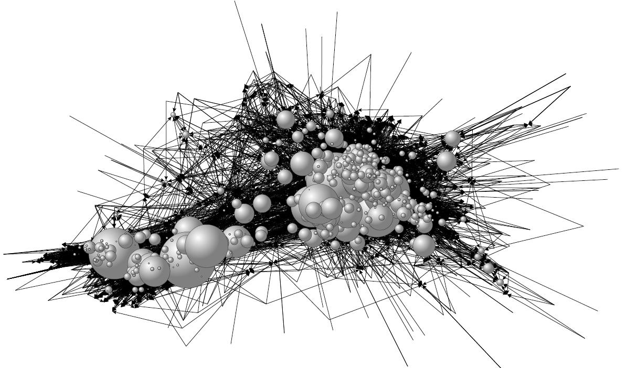
Semantic Nets, Inheritance and Frames

Slide 6
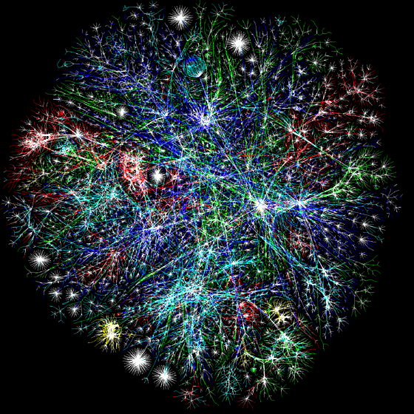
Semantic Nets
A semantic network is often used as a form of knowledge representation. It is a directed graph consisting of vertices which represent concepts and edges which represent semantic relations between the concepts.
The major idea is that:
The meaning of a concept comes from its relationship to other concepts.
The information is stored by interconnecting nodes with labeled arcs.

Slide 7
Semantic Nets
A semantic net is a structure which is used to represent associations between objects.
A semantic network consists of
  a set of nodes that represent concepts
  labeled arcs that connect nodes representing relations between concepts.

Slide 8
Common Semantic Relations
The following relations are very common:
INSTANCE: X is an INSTANCE of Y if X is a specific example of the general concept Y.
Example: Ram is an INSTANCE of Human
ISA: X ISA Y if X is a subset of the more general concept Y.
Example: sparrow ISA bird
HASPART: X HASPART Y
Example: sparrow HASPART tail

Slide 9
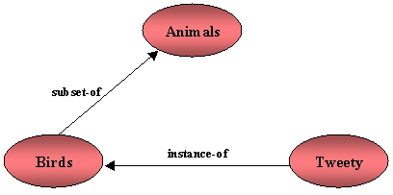
Semantic Nets:Example 1

Slide 10
Semantic Nets:Example 2
Knowledge represented as a network or graph
haspart
Animal
head
subclass
subclass
Reptile
Mammal
subclass
livesin
Elephant
large
Africa
size
instance
Pappu
apples
likes

Slide 11
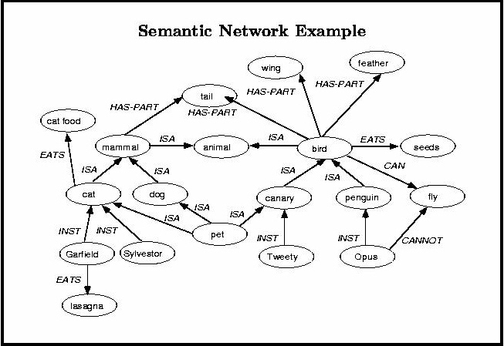

Slide 12
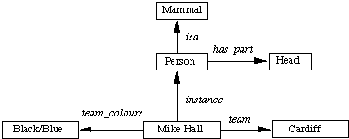
Representation using
Semantic Nets
The physical attributes of a person can be represented as:
These values can also be represented
in logic as:
isa(person, mammal),
instance(Mike-Hall, person)
team(Mike-Hall, Cardiff)
Semantic Net

Slide 13
Partitioned Semantic Nets
Used to represent quantified expressions
The SN is partitioned into a set of hierarchical spaces, each corresponding to the scope of a variable.
The dog bit the mail carrier.
Dog
Bite
Mail-carrier
Is-a
Is-a
Is-a
assailant
victim
d
b
m
bite(dog, mail-carrier)

Slide 14
Partitioned Semantic
Nets cont.
b) Every dog has bitten a mail carrier.
S
GS
Dogs
Bite
Mail-carrier
Is-a
S1
Is-a
Is-a
Is-a
form
assailant
victim
d
b
m
g
∀d: ∃m: Dogs(d) ∧ mail-carrier(m) → bite(d,m)
GS: General Statement, S: Space, S1: Subspace of S.

Slide 15
Partitioned Semantic
Nets cont.
Every dog in town has bitten the constable.
∀d : ∃c: TownDogs(d) ∧ Constable(c) → bite(d,c)
S
Dogs
GS
Bite
Constables
Town-Dogs
Is-a
S1
Is-a
Is-a
Is-a
form
assailant
victim
d
b
c
g

Slide 16
Partitioned Semantic
Nets cont.
d) Every dog has bitten every mail carrier.
∀d,m: dog(d) ∧ mail-carrier(m) → bite(d,m)
S
Dogs
Bite
Mail-carrier
S1
Is-a
Is-a
Is-a
assailant
victim
d
b
m
form
GS
g
Is-a

Slide 17
INHERITANCE

Slide 18
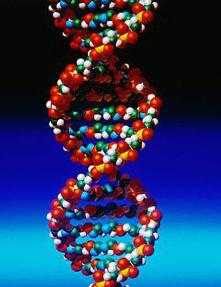
Inheritance
Inheritance is a key concept in semantic networks and can be represented naturally by following ISA links.
In general, if concept X has property P, then all concepts that are a subset of X should also have property P.
In practice, inherited properties are usually treated as default values. If a node has a direct link that contradicts an inherited property, then the default is overridden.

Slide 19
Inheritance
Is-a slot –
  appears between objects and classes.
ako (a-kind-of) slot –
appears between subsets.

Slide 20
Inheritance - Example
Block
ako
ako
shape
shape
rectangular
Wedge
Triangular
Brick
Is-a
Is-a
Wedge18
Brick12

Slide 21
FRAMES

Slide 22
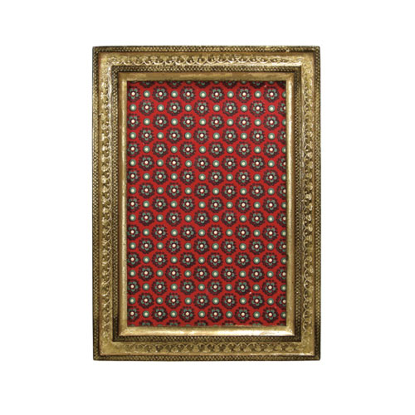
Frames
Frames : A collection of nodes that describe a stereotyped object, act or event.
Example : newspaper report.

Slide 23
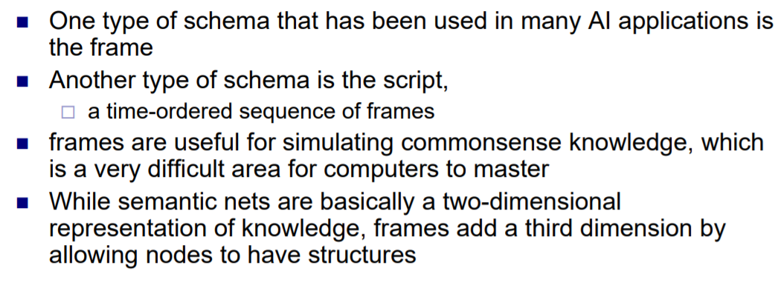
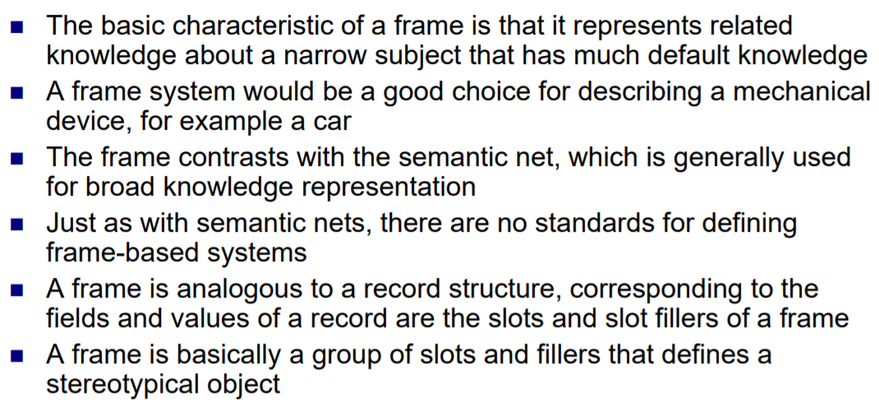
FRAMES

Slide 24
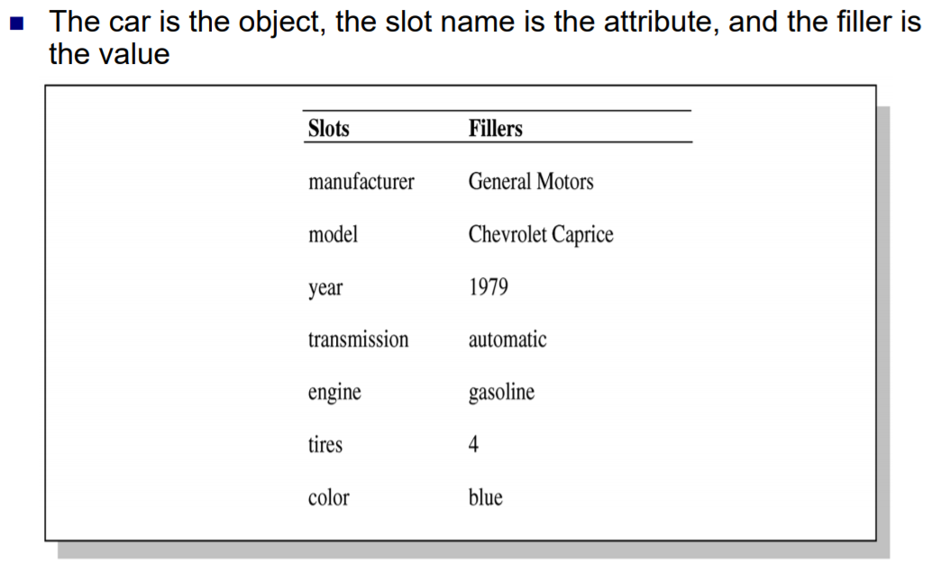
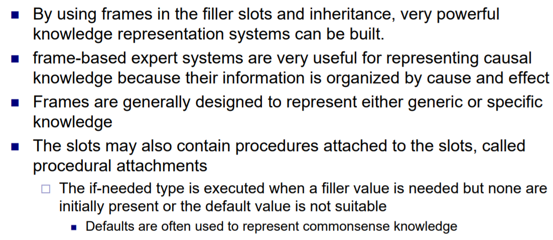
Frames: Example

Slide 25
Frames
A frame describes some real-world entity and is a collection of
  Attributes (slots), and
  A single value or a set of values associated to an attribute.
A frame can represent
  A specific entity, or
  A general concept.
Frames are implicitly associated with one another because the value of a slot can be another frame.

Slide 26
Frames: Example 1
Mammal:
subclass: animal
Elephant:
subclass: mammal
size: large
haspart: trunk
Pappu:
instance: elephant
likes: apples

Slide 27
Frames: Example 2
Mammal
isa: ANIMAL
*haspart: HAIR
*breathes: AIR
Human
isa: MAMMAL
cardinality: 6 million
haspart: LEGS(2)
Adultmale
isa: HUMAN
gender: male
Cricket Player
isa: ADULTMALE
*height: 6'
Kapil Dev
instance: CRICKETPLAYER
height: 6'
Sachin
instance:CRICKETPLAYER
height: 5’5’’
An asterisk (*) means that the slot can be inherited.

Slide 28
Frames: Example 3
Disaster-event
Event
Killed
Place
Injured
Day
Homeless
Time
Damage
Earthquake
Social-event
Magnitude
Number-of-guests
Fault
Flood
Host
Crest
River
Birthday-party
Hurricane
Birthday-person
Wind-speed
Name
Age

Slide 29
Frame-Earthquake Example cont.
Earthquake Hits the Himalayas
Today an extremely serious earthquake of magnitude 8.4 hit the Himalayas killing 250000 people and causing $500,000,000 in damage. The president of India said the hard-hit area near the Nepal fault has been a danger zone for years.

Slide 30
Earthquake Example cont.
Earthquake15
place
The Himalayas
day
Today
fatalities
250000
damage
500,000,000
magnitude
8.4
fault
Nepal

Slide 31
